Slide 1

Anthony Bourdain’s Travels
Data Deviants
Project 3, Group 2
Van Eisele
Carlos De La Rosa
Abagail Chambers

Slide 2

Introduction
Inspiration
We all love food, and we all love Anthony Bourdain, so it was not a difficult decision to delve into his travels for app.
Dataset
https://www.kaggle.com/datasets/michaelbryantds/anthony-bourdain-episode-locations?resource=download

Slide 3



Design Inspiration
Color Scheme
We went with a mostly earthy palette, with pops of red and blue for emphasis.
Some examples of our colors:
Image Inspiration

Slide 4
Data Engineering
Data Cleaning
Our open-source dataset download provided two CSV files, though our group realized early on that only one of those was useful for our purposes, the other being a truncated and reformatted version of the same data. Once we read in our primary CSV, we found the data itself to be relatively clean. We dropped a total of four columns as unnecessary, only needed to convert a single column’s data format, and renamed only a single column header.
Distance Calculation
Great-Circle Distance vs. Euclidean Distance
In our mapping efforts, it came to our attention that our initial distance calculations were based on straight-line distances, otherwise known as the Euclidean space between two points. Correcting this required mathematical conversion to great-circle distance, which is still the distance between points, but measured along the surface of a sphere. Using this conversion was a slower method but produced more accurate results.

Slide 5



Research Questions and App Demo

Slide 6
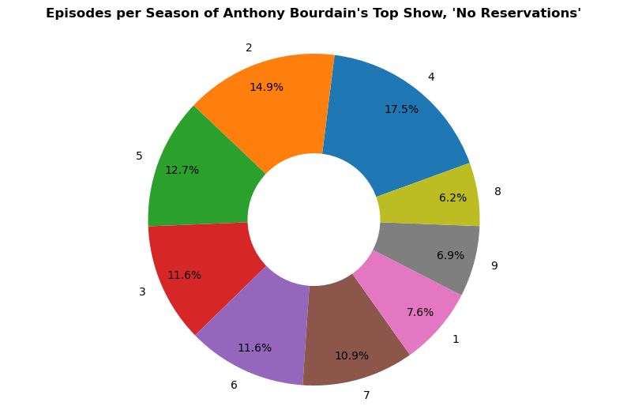
What was Anthony Bourdain’s top show? ‘No Reservations’ aired a total of 275 episodes over the course of 2,660 days, which is just over 7 years. ‘Parts Unknown’ aired 158 episodes over 1,897 days, or just over 5 years. ‘A Cook’s Tour’ aired 42 episodes over 454, or just over 1 year. ‘The Layover’ aired only 20 episodes over 441 days, also just over 1 year.

Slide 7
Do we see any trends in the areas or countries of his travels? ‘No Reservations’ aired a total of 275 episodes over the course of 2,660 days, which is just over 7 years. ‘Parts Unknown’ aired 158 episodes over 1,897 days, or just over 5 years. ‘A Cook’s Tour’ aired 42 episodes over 454, or just over 1 year. ‘The Layover’ aired only 20 episodes over 441 days, also just over 1 year.

Slide 8
Do we see any trends in the areas or countries of his travels? ‘No Reservations’ aired a total of 275 episodes over the course of 2,660 days, which is just over 7 years. ‘Parts Unknown’ aired 158 episodes over 1,897 days, or just over 5 years. ‘A Cook’s Tour’ aired 42 episodes over 454, or just over 1 year. ‘The Layover’ aired only 20 episodes over 441 days, also just over 1 year.

Slide 9
ydata_profiling ‘No Reservations’ ‘Parts Unknown’

Slide 10
Conclusions:
“Travel is fatal to prejudice, bigotry, and narrow-mindedness.” – Mark Twain.
Anthony Bourdain spent over a decade of his life traveling the globe, eating, drinking and experiencing other regions, countries, and cultures, so that his viewers could be exposed to information they might not otherwise ever be privy to.
Limitations & Bias: We would have really liked to have been able to use food data. Unfortunately, our dataset did not include any specific dish data. The only place our team was able to find such information would have required a great deal of web scraping, which would have taken more time than we had to complete this project. Also, in terms of the travel distances, our calculations represent a cumulative path between unique locations; whereas, in reality, he could have traveled back to his home city of New York between some, or all, of his trips, amassing a great number more overall miles traveled.
Future Work: It would be really interesting to acquire food data for all his various travels, and to be able to include that data in our mapping. Perhaps we could also try to hunt down additional data about his actual travel paths to produce more accurate mileage calculations.

Slide 11

Thank you

